Slide 1




About EACH
30 Years of Enabling Change and Rebuilding Lives
EACH are a leading voluntary sector organisation in North & West London
We provide holistic and culturally sensitive services
EACH aim to empower and support people to improve their health, wellbeing and financial standing
EACH’s strands
Mental Health
Substance Misuse
Domestic Violence
@EACHCounselling

Slide 2
About EACH (continued)
We are a needs-led organisation i.e. services are designed in response to the issues experienced by the local community
The focus of our efforts are on supporting :
- BAMER communities
-Those who are less likely to engage with mainstream services
- Women on their journey to recover from domestic abuse
Further information can be found on our website: ww.eachcounselling.org.uk

Slide 3
The organisation provides services in 11London boroughs
In west London for boroughs of:
Brent, Ealing, Harrow, Hounslow, Hillingdon as well as Hammersmith & Fulham
In south west London for boroughs of:
Wandsworth, Kingston, Richmond and Merton
In north London for
Barnet

Slide 4
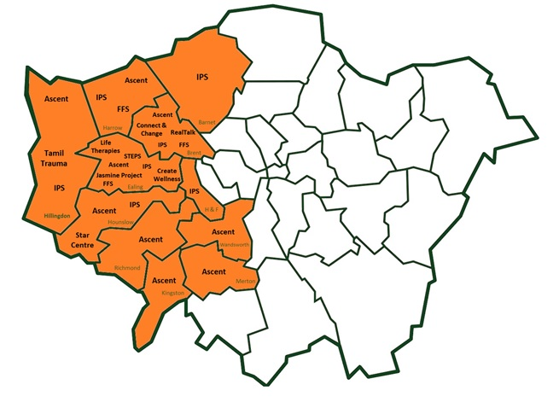
Map of geographical reach

Slide 5
Example of EACH’s services
1-2-1 trauma counselling for specific groups e.g. for:
  Women suffering domestic abuse
  Tamil refugees
Therapeutic groups
Psycho-education services
Support for clients to achieve motivational/behavioural change
Practical support to individuals using the care coordination approach
Tailored education & employment services for BAME individuals recovering from mental ill-health
Notes:
Housing-related support including Out of Hospital support for those released from Mental Health units at Ealing Hospital, Central Middlesex and charring Cross
Mental health engagement and support for people under supervision of Community Mental Health case management Teams
Volunteering programmes (clinical & peer)
Recovery Mental Health Peer Support,

Slide 6
Services (continued)
We have a number of housing-related projects e.g. Out of Hospital support for those released from Mental Health units at Ealing, Central Middlesex and Charring Cross
EACH engages with those under the supervision of Community Mental Health Teams
Provide recovery and peer support services for MH clients
Clinical and peer based volunteering opportunities

Slide 7
Referrals
Individuals must meet the criteria for the particular service
They are made by health & social care, housing and voluntary sector professionals or by self-referral
Acceptance decisions are based on:
  -Information presented in referral form (available on EACH website)
  -Meeting the eligibility criteria for the particular service they have been referred to
  -Initial Assessment & risk assessment

Slide 8
About Ealing COVID Community Engagement Programme
The programme is designed to deliver interventions at three levels:
  Raise awareness
  Increase understanding
  Enable residents to protect themselves and prevent the spread of the disease

Slide 9
How is the programme delivered
Through a Consortium model that is still being developed
Members are selected from Ealing’s third sector
Those who join must have experience of health related initiatives
Projects can focus on one, two or all of the following three themes:
  Raise awareness of issues relating to COVID
  Work to create an understanding of the risks of covid
  Help equip users with covid knowledge that protects them as well as others around them

Slide 10
Programme’s outcomes via the Consortium
In addition to the actual delivery, the programme hopes to:
Collate feedback from service users to pass on to partners to inform future work and influence policy
Collate case studies of impact of info & advice on SUs
Furthermore we hope to find out:
  what works for our target groups
  what doesn’t work
  what could be improved and how
Deliver services to users that are culturally appropriate & equitable for hard to reach groups

Slide 11
Examples of Communication Media
Our work will be delivered via
Digital & social media e.g. mailshots, circulars, online publications, Facebook and podcasts
Utilize Zoom, Google Meet,Teams, WhatsAp & phone to facilitate:
  group sessions, run competitions, etc.
  face to face advice and support sessions
  Ad hoc conversations
Use traditional media such leaflets

Slide 12
Any questions
Contacts:
Rosita Tehrani: rtehrani@eachcounselling.org.uk, mobile:07425916427
Mamta Khanna: mkhanna@eachcounselling.org.uk, 07453 061274
Clarissa Stoneham: cstoneham@eachcounselling.org.uk
Lakhvir Randhawa: lrandhawa@eachcounselling.org.uk

